Slide 1
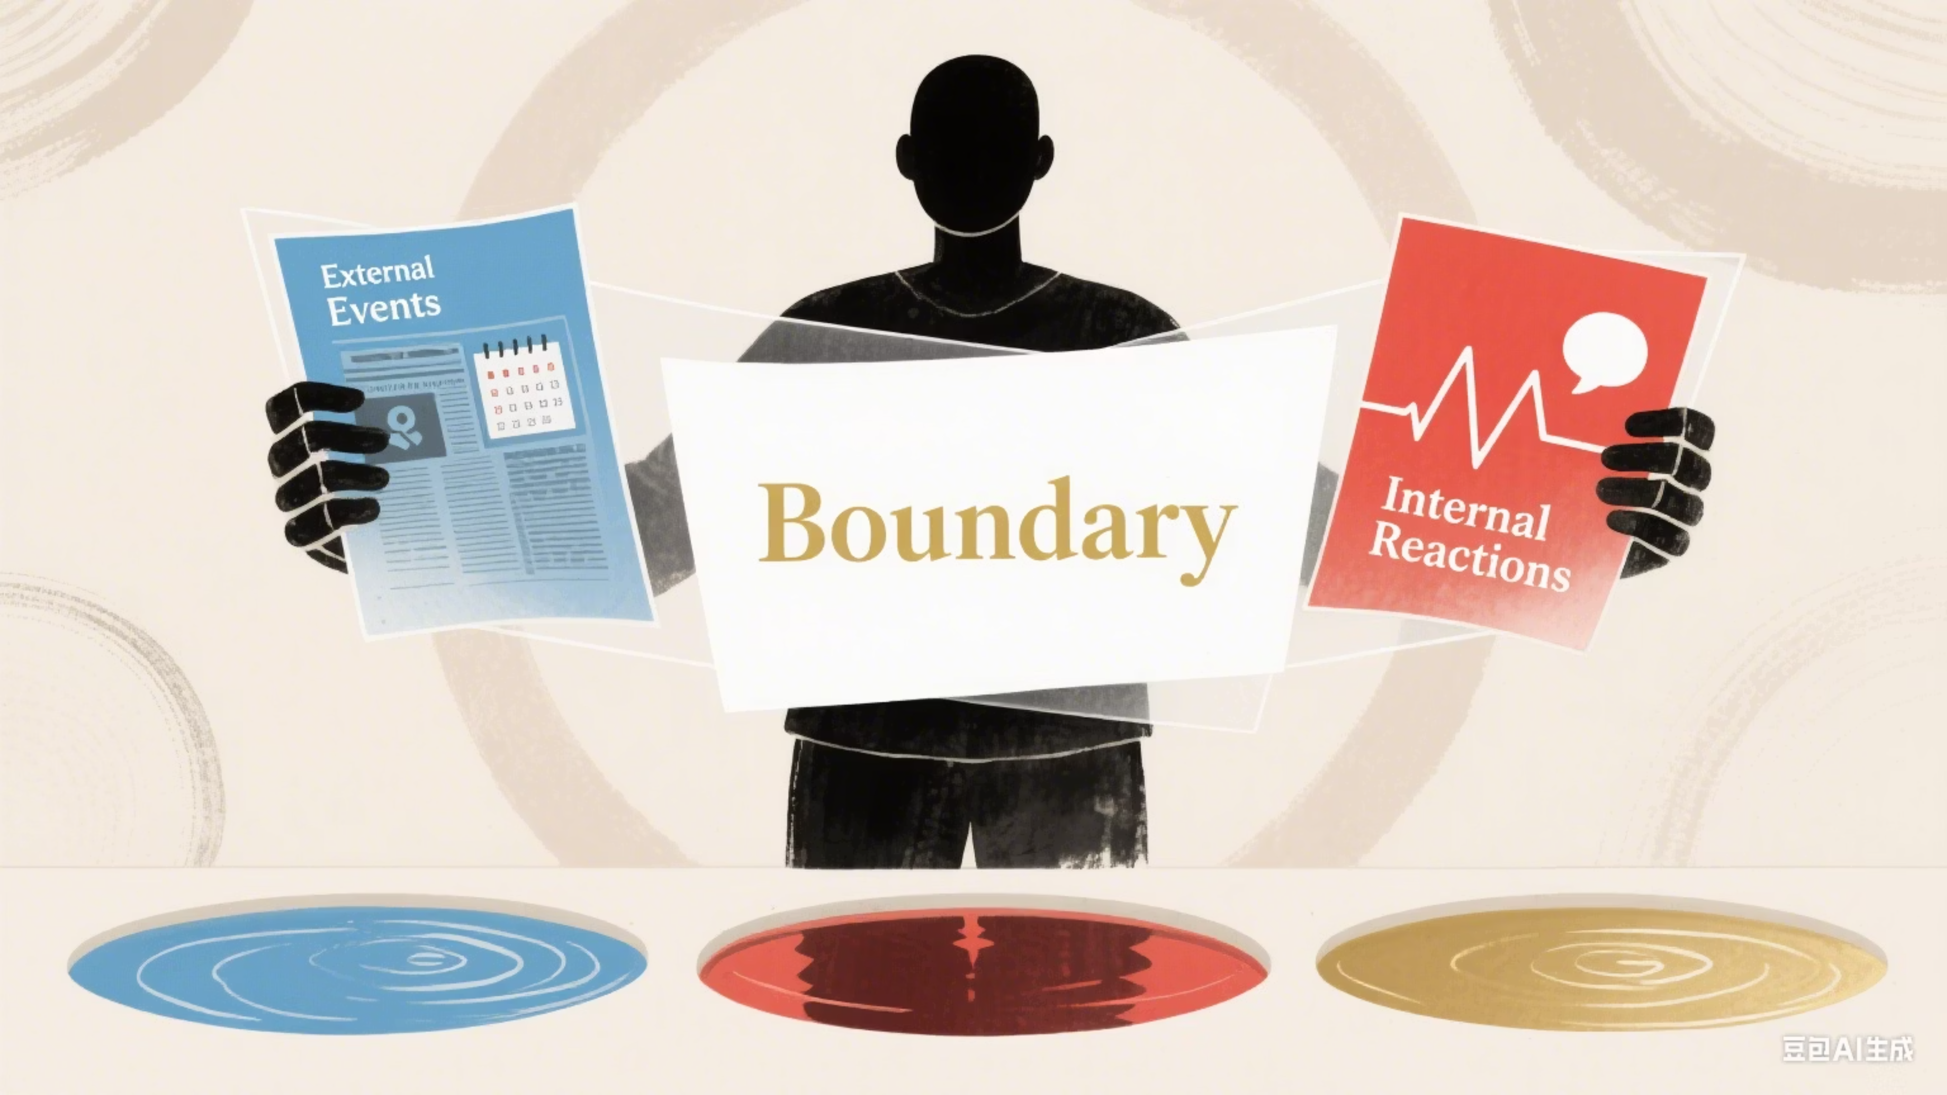
Topic Separation
Reduce Stress, Think Clearly
Notes:
• The topic of today's presentation is understanding topic separation - a key strategy for reducing stress and overthinking. • As the title suggests, this is your guide to achieving greater focus and clarity by separating different topics or tasks. • We'll explore why topic separation is so important for your productivity and mental wellbeing, and provide practical tips you can start using right away. • The goal is to help you feel more in control of your time and thoughts, and free up mental space to tackle what really matters. • Let's dive in and discover how topic separation can lead to less stress and overthinking in your daily life.

Slide 2


Topic Separation: Key Insights from Alfred Adler
What it is: Distinguishing what's within your control from what's not.
How to apply: Ask "Whose business is this?"
When to use: When facing stress or overthinking.
Outcome: If it's "your business," focus your energy. If it's "others' business," release anxiety.
Benefits: Reclaim mental space, reduce stress, stop trying to control the uncontrollable.
Your Business
Others' Business
Your actions
Their opinions of you
Your feelings
Their actions
Your reactions
Their decisions
Notes:
The key insight from Alfred Adler that we'll explore today is the concept of topic separation - distinguishing what's within your control from what's not. The core idea is to ask yourself "Whose business is this?" When facing stress or overthinking, this question can help you reclaim your mental space. If it's "your business" - your actions, feelings, and reactions - then you should focus your energy there. But if it's "others' business" - their opinions of you, their actions, their decisions - then you need to release that anxiety. The benefits of applying topic separation are significant. It allows you to reduce stress, stop trying to control the uncontrollable, and reclaim your mental space. Let's dive deeper into the distinction between your business and others' business, and how to practically apply this framework.

Slide 3


Applying Topic Separation
Example 1: Friend Cancels Plans
When a friend cancels plans, avoid self-blame.
Their choice = Their business | Your calm reaction = Your business
Example 2: Receiving Criticism
When someone criticizes you, don't internalize it.
Their criticism = Their business | Your response = Your business
Notes:
The topic of this slide is applying topic separation, which means not taking personal responsibility for things that are out of your control. The first example is about when a friend cancels plans. The key point is that their choice to cancel is their own business, and your calm reaction is your own business. The second example is about receiving criticism. The important thing is to not internalize the criticism, as that is the other person's business, while your response is your own business. The slide emphasizes that we should separate what is within our control (our own reactions and responses) from what is outside our control (the actions and choices of others). This skill of topic separation can help us maintain our composure and not take things personally in difficult interpersonal situations.

Slide 4
How to Practice?
Focus on your part
Classify
Let go of others' business!
Notice stress
"Can I control this? (My/ Others' business)"
E.g.: Someone is rude (theirs) → You stay calm (yours)
Pause: "What am I worried about?"
Notes:
Notice when you're feeling stressed - pause and ask yourself "What am I worried about?" Classify what you can and can't control. Focus on your own actions, not others' behavior. When someone else is acting up, let go of their business and focus on staying calm yourself. You can't control their actions, but you can control how you respond.

Slide 5



Setting Kind Boundaries
Their Choices, Their Responsibility
You can't fix others' moods or decisions. Focus on your own actions and kindness.
Safeguard Your Peace
Don't let external events or others' actions dictate your inner calm.

Slide 6

Small Shift = Big Calm!
Focus on your business → Less stress, more control of your feelings
Tip: Next time you feel overwhelmed → Ask: "Whose business is this?"
Ever stressed from mixing up "your/others' business"?
Thank You!
Notes:
• The key message is that by focusing on your own business rather than others', you can reduce stress and have more control over your emotions. • Explain that it's easy to get caught up in worrying about things that aren't our responsibility. This can lead to feeling overwhelmed. • Highlight the "Tip" callout box - suggest that when you feel stressed, pause and ask yourself "Whose business is this?" This can help you refocus on what's within your control. • Emphasize that this simple shift in mindset can make a big difference in managing your stress levels. • Conclude by thanking the audience and expressing excitement about the topic.

